Slide 1
Crop Recommendation System Using Machine Learning

Slide 2
Agenda
Problem Definition
Data Understanding and Preprocessing
Exploratory Data Analysis (EDA)
Model Building and Evaluation
Deployment using Streamlit UI
Power Bi Visualization
Conclusion.

Slide 3
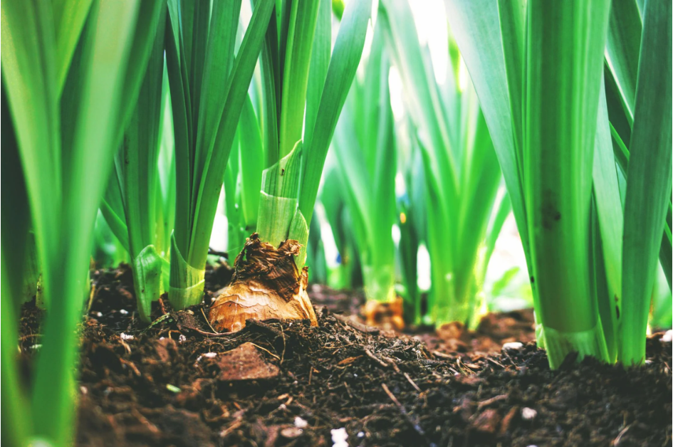

Slide 4
Problem Definition
Agriculture is the backbone of many economies, and farmers often face difficulties in deciding which crop to grow for maximum yield and profitability. The choice of crop depends on multiple factors such as soil nutrients (N, P, K levels), climate conditions (temperature, humidity, rainfall), and soil pH. A wrong choice of crop can lead to low productivity, financial losses, and inefficient use of resources. The problem is to build a machine learning model that can predict the most suitable crop for a given set of soil and climatic parameters. This is a multi-class classification problem, where each class represents a crop type (e.g., rice,wheat, maize, watermelon, etc.).
By solving this problem, we aim to:
Assist farmers in making data-driven decisions.
Improve agricultural productivity and sustainability.
Minimize risks related to unsuitable crop cultivation.

Slide 5
Data Understanding & Preprocessing
Dataset: ~2,200 records, 7 input features, 1 target label (crop type).
Features: Nitrogen (N), Phosphorus (P), Potassium (K), Temperature, Humidity, pH, Rainfall.
Preprocessing Steps:
Checked for missing values (none found).
Encoded crop names using LabelEncoder.
Outlier removal using IQR method.
Log transformation and StandardScaler applied.
Data balanced using SMOTE + Tomek Links.

Slide 6
Exploratory Data Analysis (EDA)
.Distribution: Most features became normal after transformation.
Boxplots revealed and removed outliers in nutrient and rainfall values.
Crop Distribution: Dataset includes 22 diverse crop types.
Observations:
Rice and maize thrive in high rainfall.
Pulses grow better in balanced NPK conditions

Slide 7
Model Building & Evaluation
Models Trained: Logistic Regression, Random Forest, XGBoost.
Techniques: Feature scaling, transformation, cross-validation (Stratified K-Fold).
Performance Summary:
Logistic Regression → 97% train / 96% test
Random Forest → 99% train / 98% test
XGBoost → 99% train / 98-99% test (Best Model).
XGBoost selected for deployment due to high accuracy and low overfitting.

Slide 8
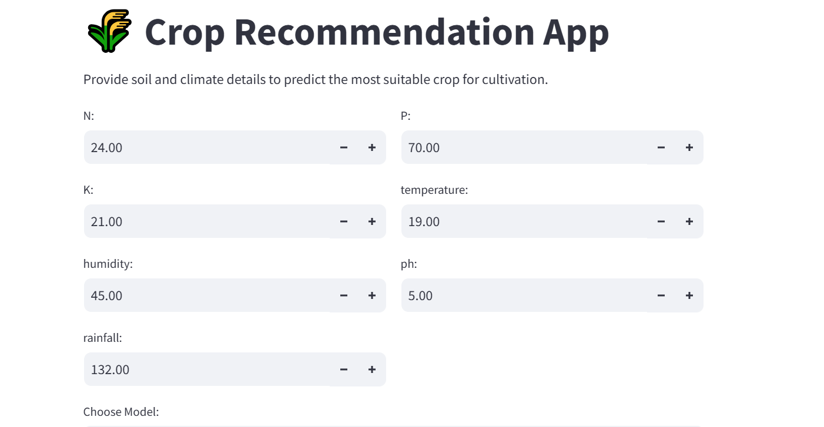

Slide 9
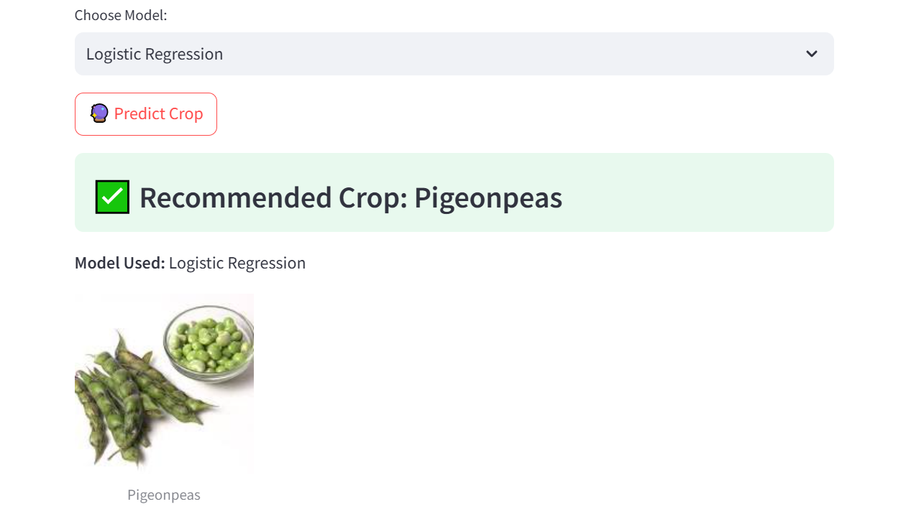

Slide 10
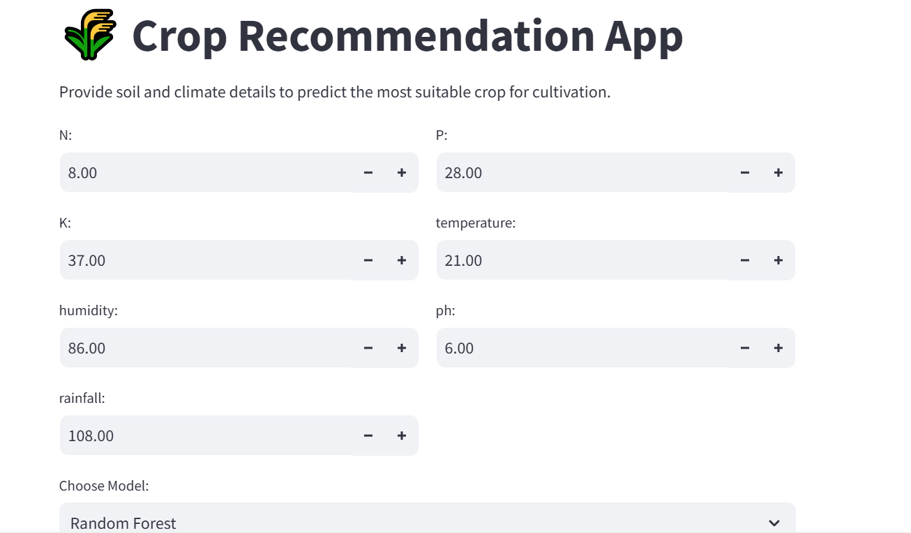

Slide 11
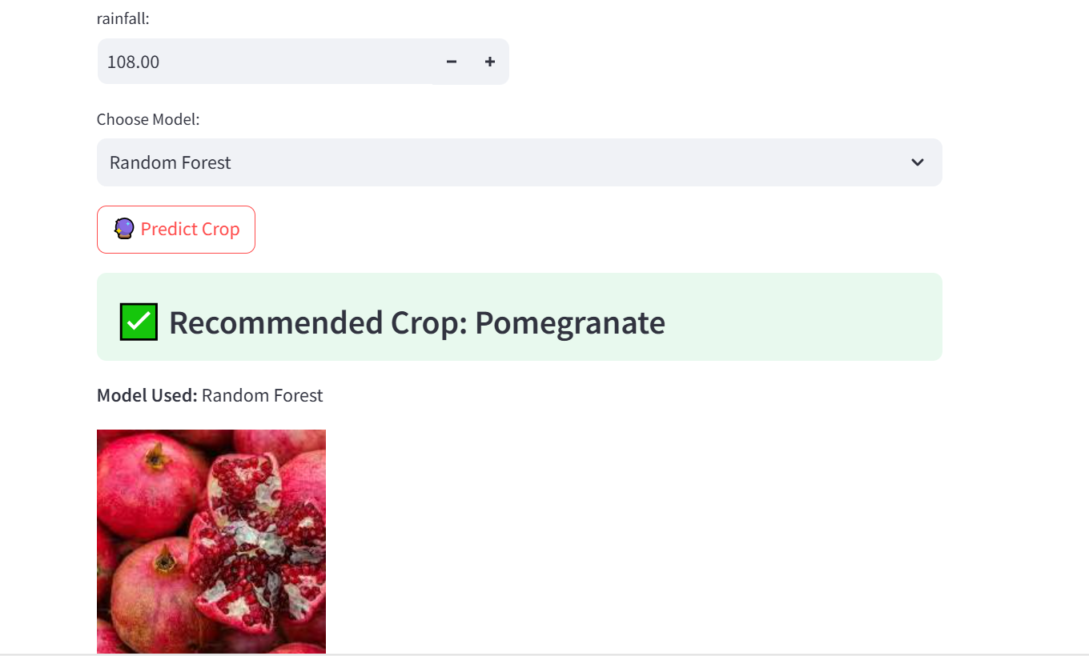

Slide 12
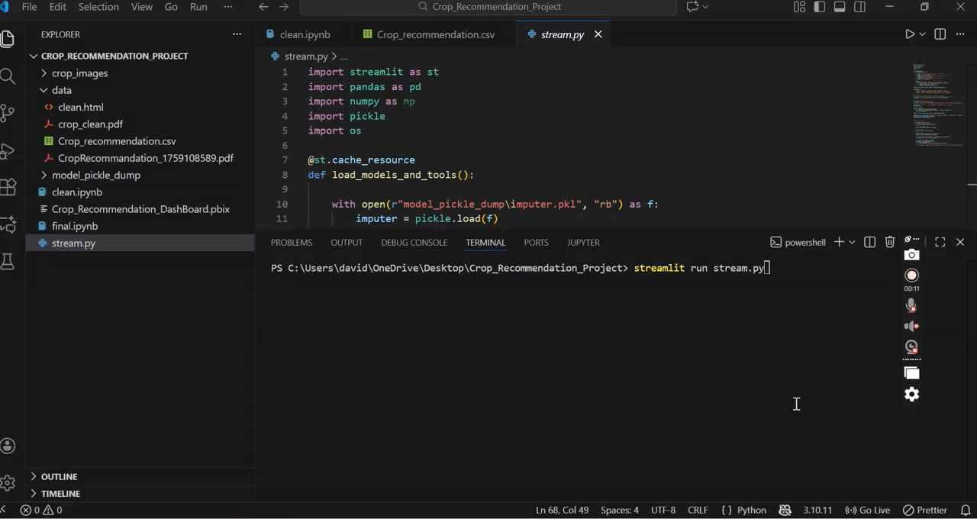

Slide 13
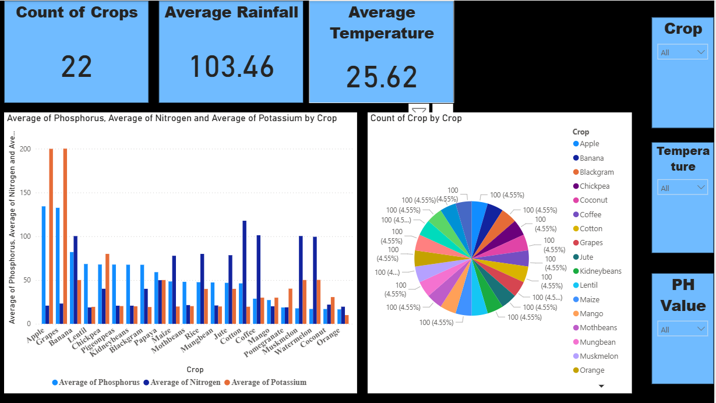

Slide 14
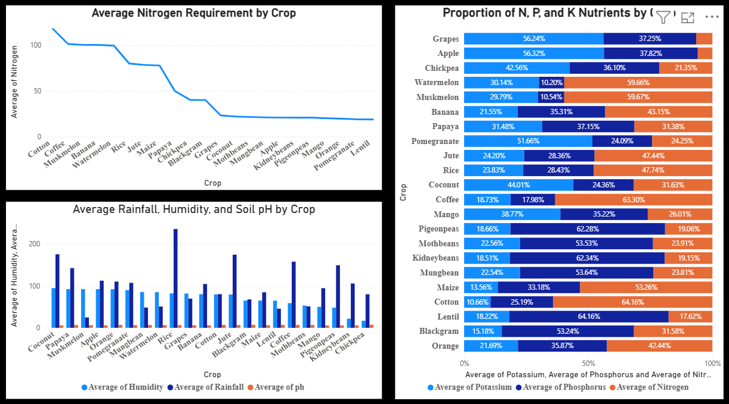

Slide 15
Conclusion
In conclusion, this project demonstrates how machine learning can support sustainable agriculture by helping farmers choose the most suitable crop for their soil.
In the future, the system can be improved by:
Integrating live weather APIs
Adding fertilizer recommendations
Building a mobile-friendly version for easy access
This project has strong real-world potential, especially for regions where farming decisions depend heavily on environmental variability.

Slide 16
Questions ?

Slide 17
Thank You!

